Slide 1
SHS Campuse
Group 4 Project
Prepared the presentation by:Burak Eraslan-Emine Işık

Slide 2
PURPOSE OF THE SHS
Our project is a "Student interaction platform based on note sharing, online or offline lecture, student advice section, also student will be able to earn money from this site.

Slide 3


Technologies
In this project, we used php as the software language. We used phpymyadmin/localhost/mySQL as Database.

Slide 4
Expression on how to use:

Slide 5
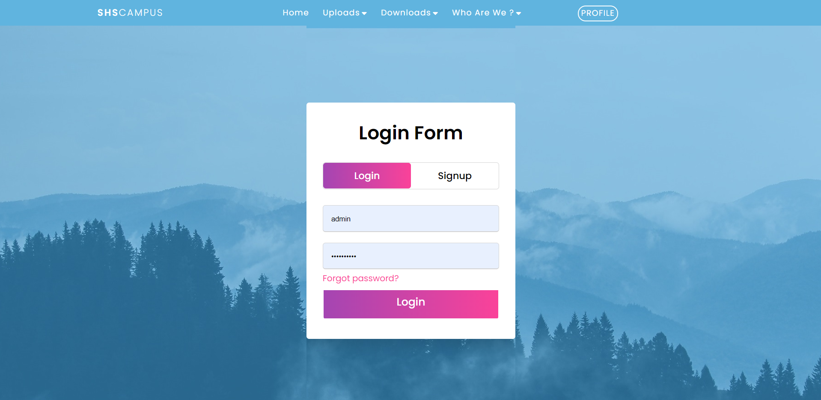
Our start page is login page. You can register or log in from here. Without login you dont have permission to access files.

Slide 6
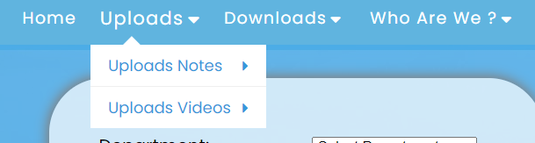
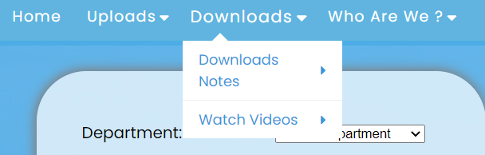
You can upload notes or links by clicking uploads tab.
You can also download notes or links by clicking uploads tab.

Slide 7
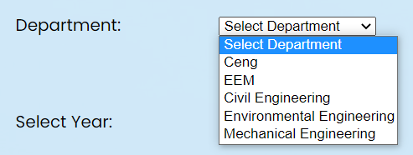
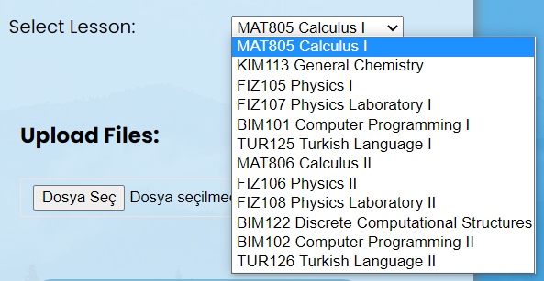
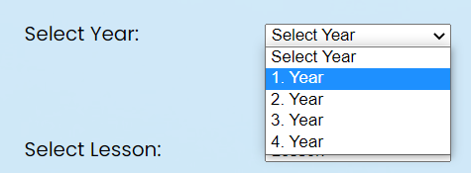
To upload or download you have to select deparment, year and lesson.

Slide 8
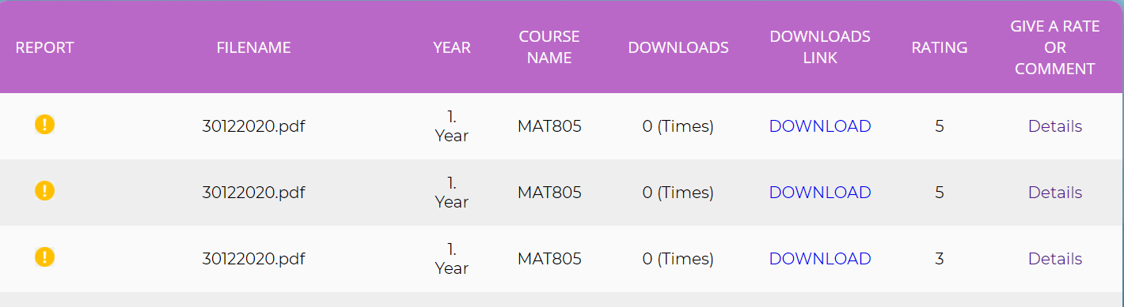
Download page there is a tab and list of files. You can download rate or report from here.

Slide 9
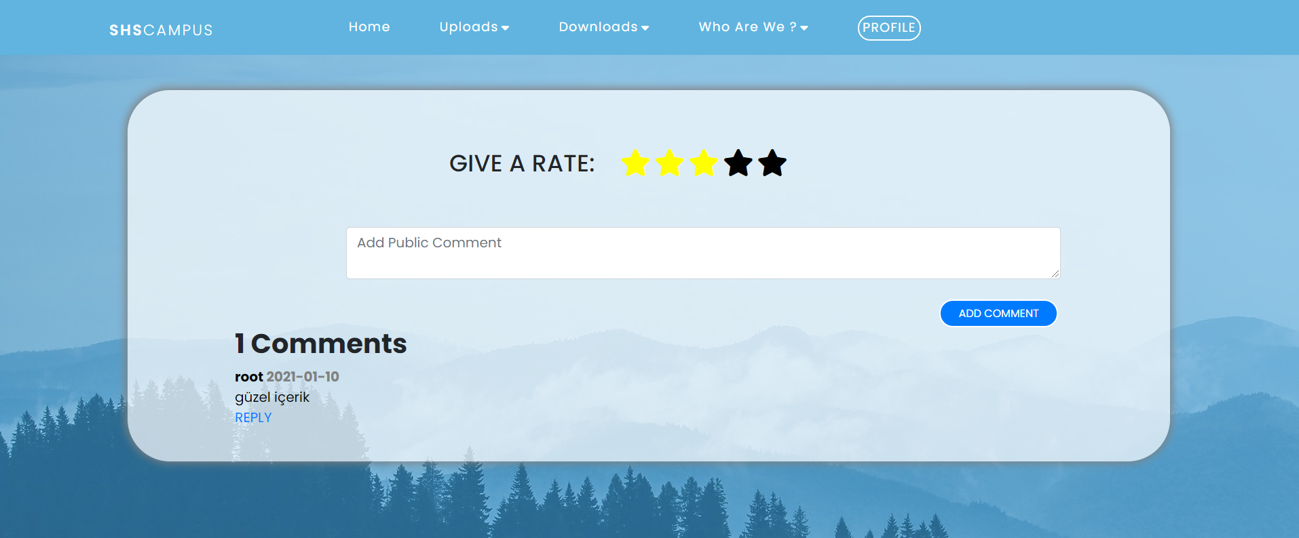
Comment and rating system:

Slide 10
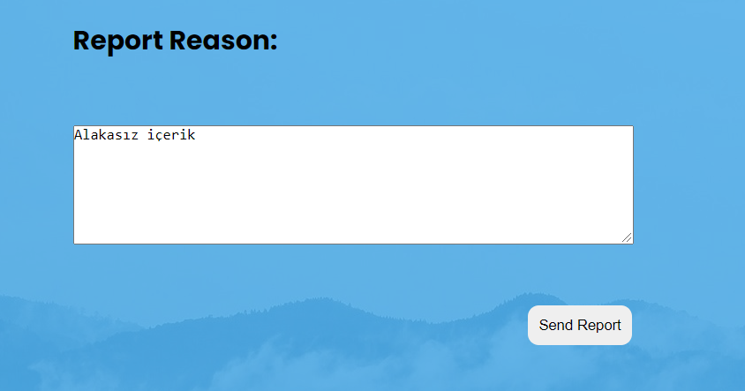
Report system:
After your report our admins can check that.

Slide 11
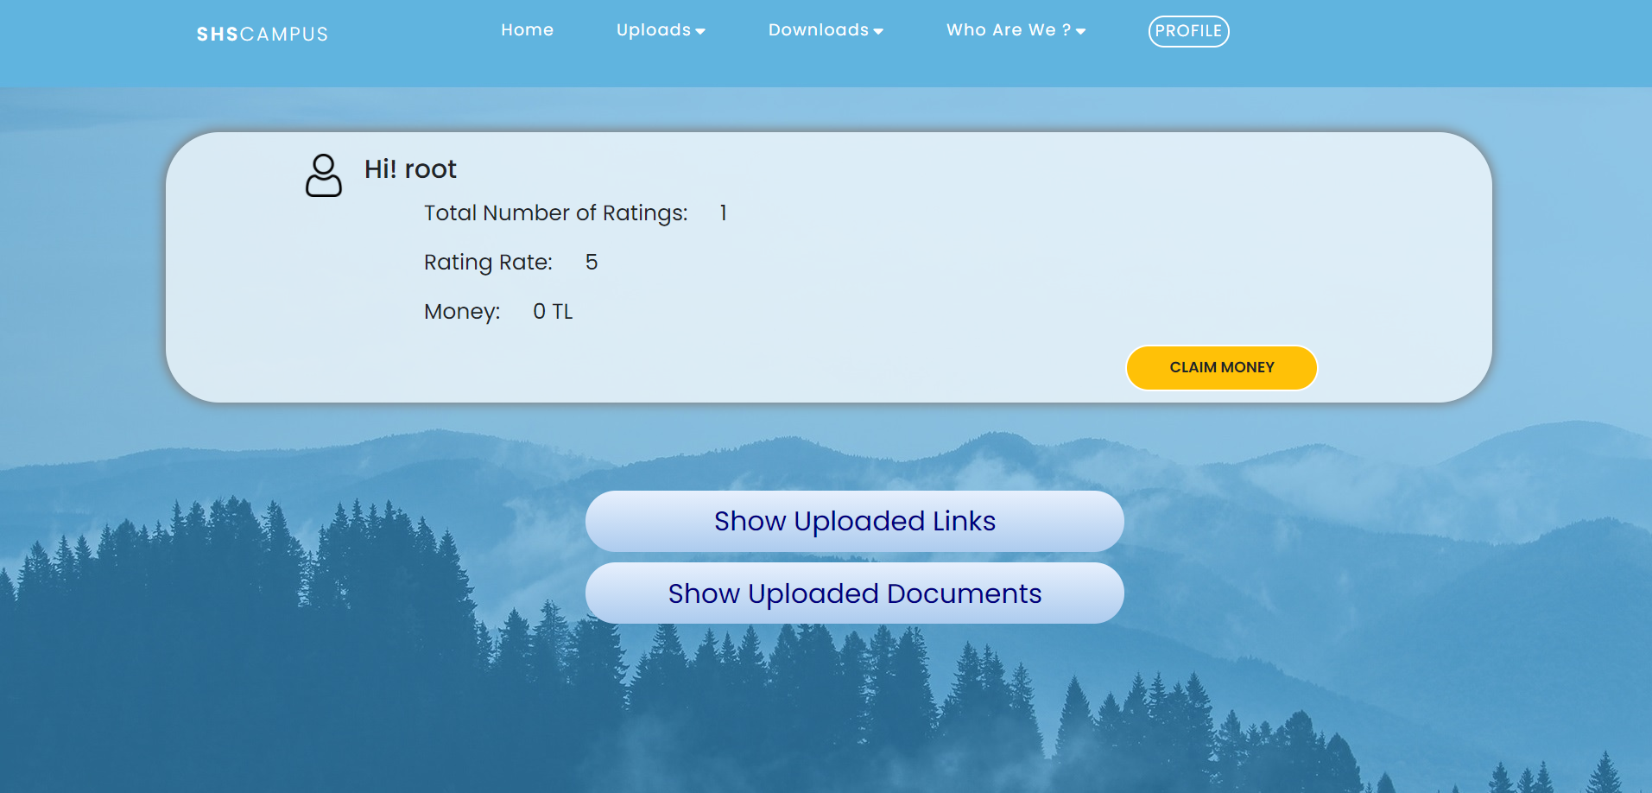
This is profile page you can earn Money from here. There is an algorithm that calculate Money according to number of rating .Also you can see your uploaded file and links from here.

Slide 12
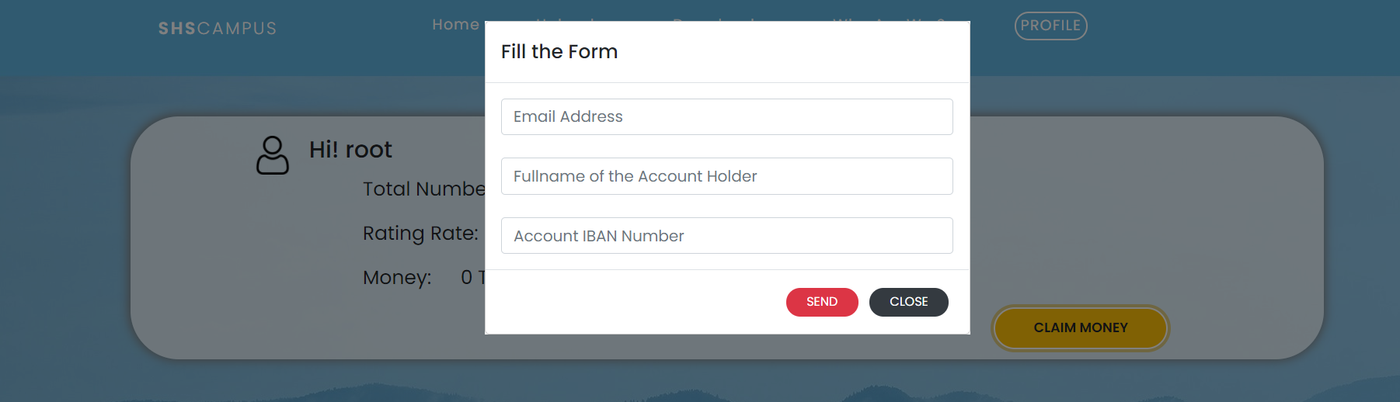
If you click claim Money. This popup page will be showed. You need to fill this informations.

Slide 13
Zaman Çizelgesi
Login/Register
1
Upload file/link
2
Download file/link
3
Command and Rate
4
Claim your easy money
5

Slide 14
Thank you.
Group Members:
Burak Eraslan, Emine Isık, Cemile Ceren Bektas, Akif Sakallıoğlu, Huseyin Gülçiçek, Alzahraa Saad
Team website:
https://homeworkforsoftwareengineering.github.io/
Project files:
https://github.com/HomeworkForSoftwareEngineering/files

